Slide 1
EVENT RECAPPING + UET Overview
October 2023

Slide 2
Overview
Momentum Data collection
  How Field Marketing fits into our UET vision
Field Marketing Platform Comparisons
  Brandscopic
    What it is, who will use it
Event Creation
  Brandscopic + Smartsheets
Recapping
  BA Recaps
Timing
  Program roll out
    Small number of events to roll out, starting once the SSO is in place
  October 2023; events entered
  Schedule (during launch, feedback link, launch)

Slide 3
Unified Experience Tracker

Slide 4
Today
Momentum gathers meaningful post-event metrics by unifying data from different sources. ​
​
Information is either not available or not shared in a timely manner.​
This limits Momentums spend and agility when generating insights.​

Slide 5
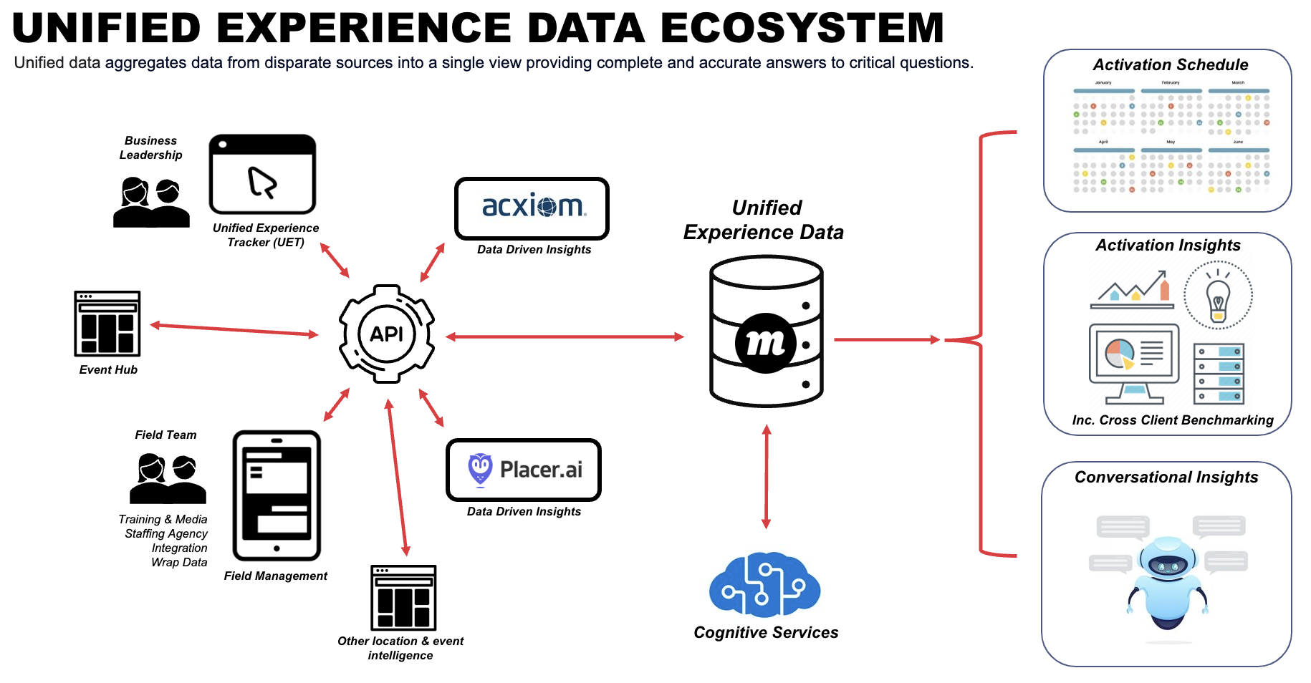

Slide 6
Field Marketing - Comparisons

Slide 7
Recapping Platform Features
Out of the 14 platforms compared– these are the top 3 that meet the requirements of both Verizon and overall Momentum needs.
Features | Recapping Platform
 | Brandscopic | Pinata | Network Ninja
Dashboard View | 😊 | ❌ | 😊
Calendar | 😊 | ❌ | 😊
Bi Directional API | 😊 | ❌ | ❌
Staffing Agency Integration | ❌ | 😊 | ❌
Attachments for Event | 😊 | 😊 | ❌
Offline Data Entry | 😊 | 😊 | ❌
Media Upload and Tagging | 😊 | 😊 | 😊
SMS Event Reminders | 😊 | 😊 | ❌
Recap Notifications | 😊 | 😊 | ❌
Review Recap Reports prior to submitting | 😊 | 😊 | 😊

Slide 8
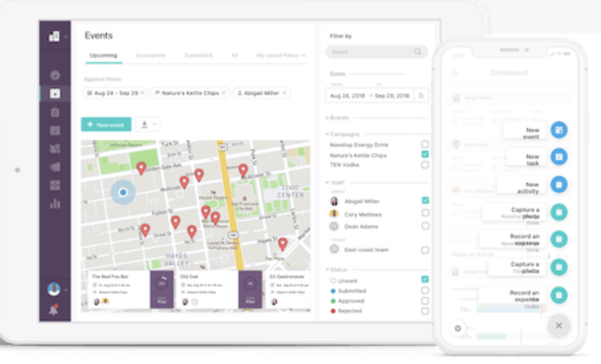
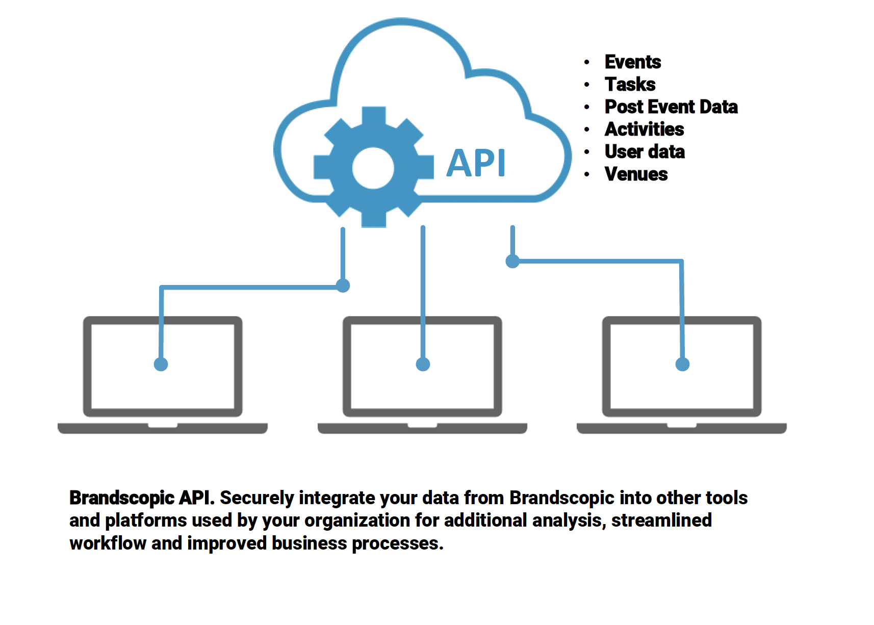
Brandscopic
Mobile App or Responsive web app
Can custom build according to our need
Configurable dashboard
Notifications, in app, sms or email
Calendar view by event, campaign or phase
Geo locate for BA or FM check in (geolocate crumbs or IP address)
Bi directional API
Staffing agencies can have accounts and then assign staff
Can partition the client portals so that Momentum would have 1 portal but multiple clients; no data overlapping

Slide 9
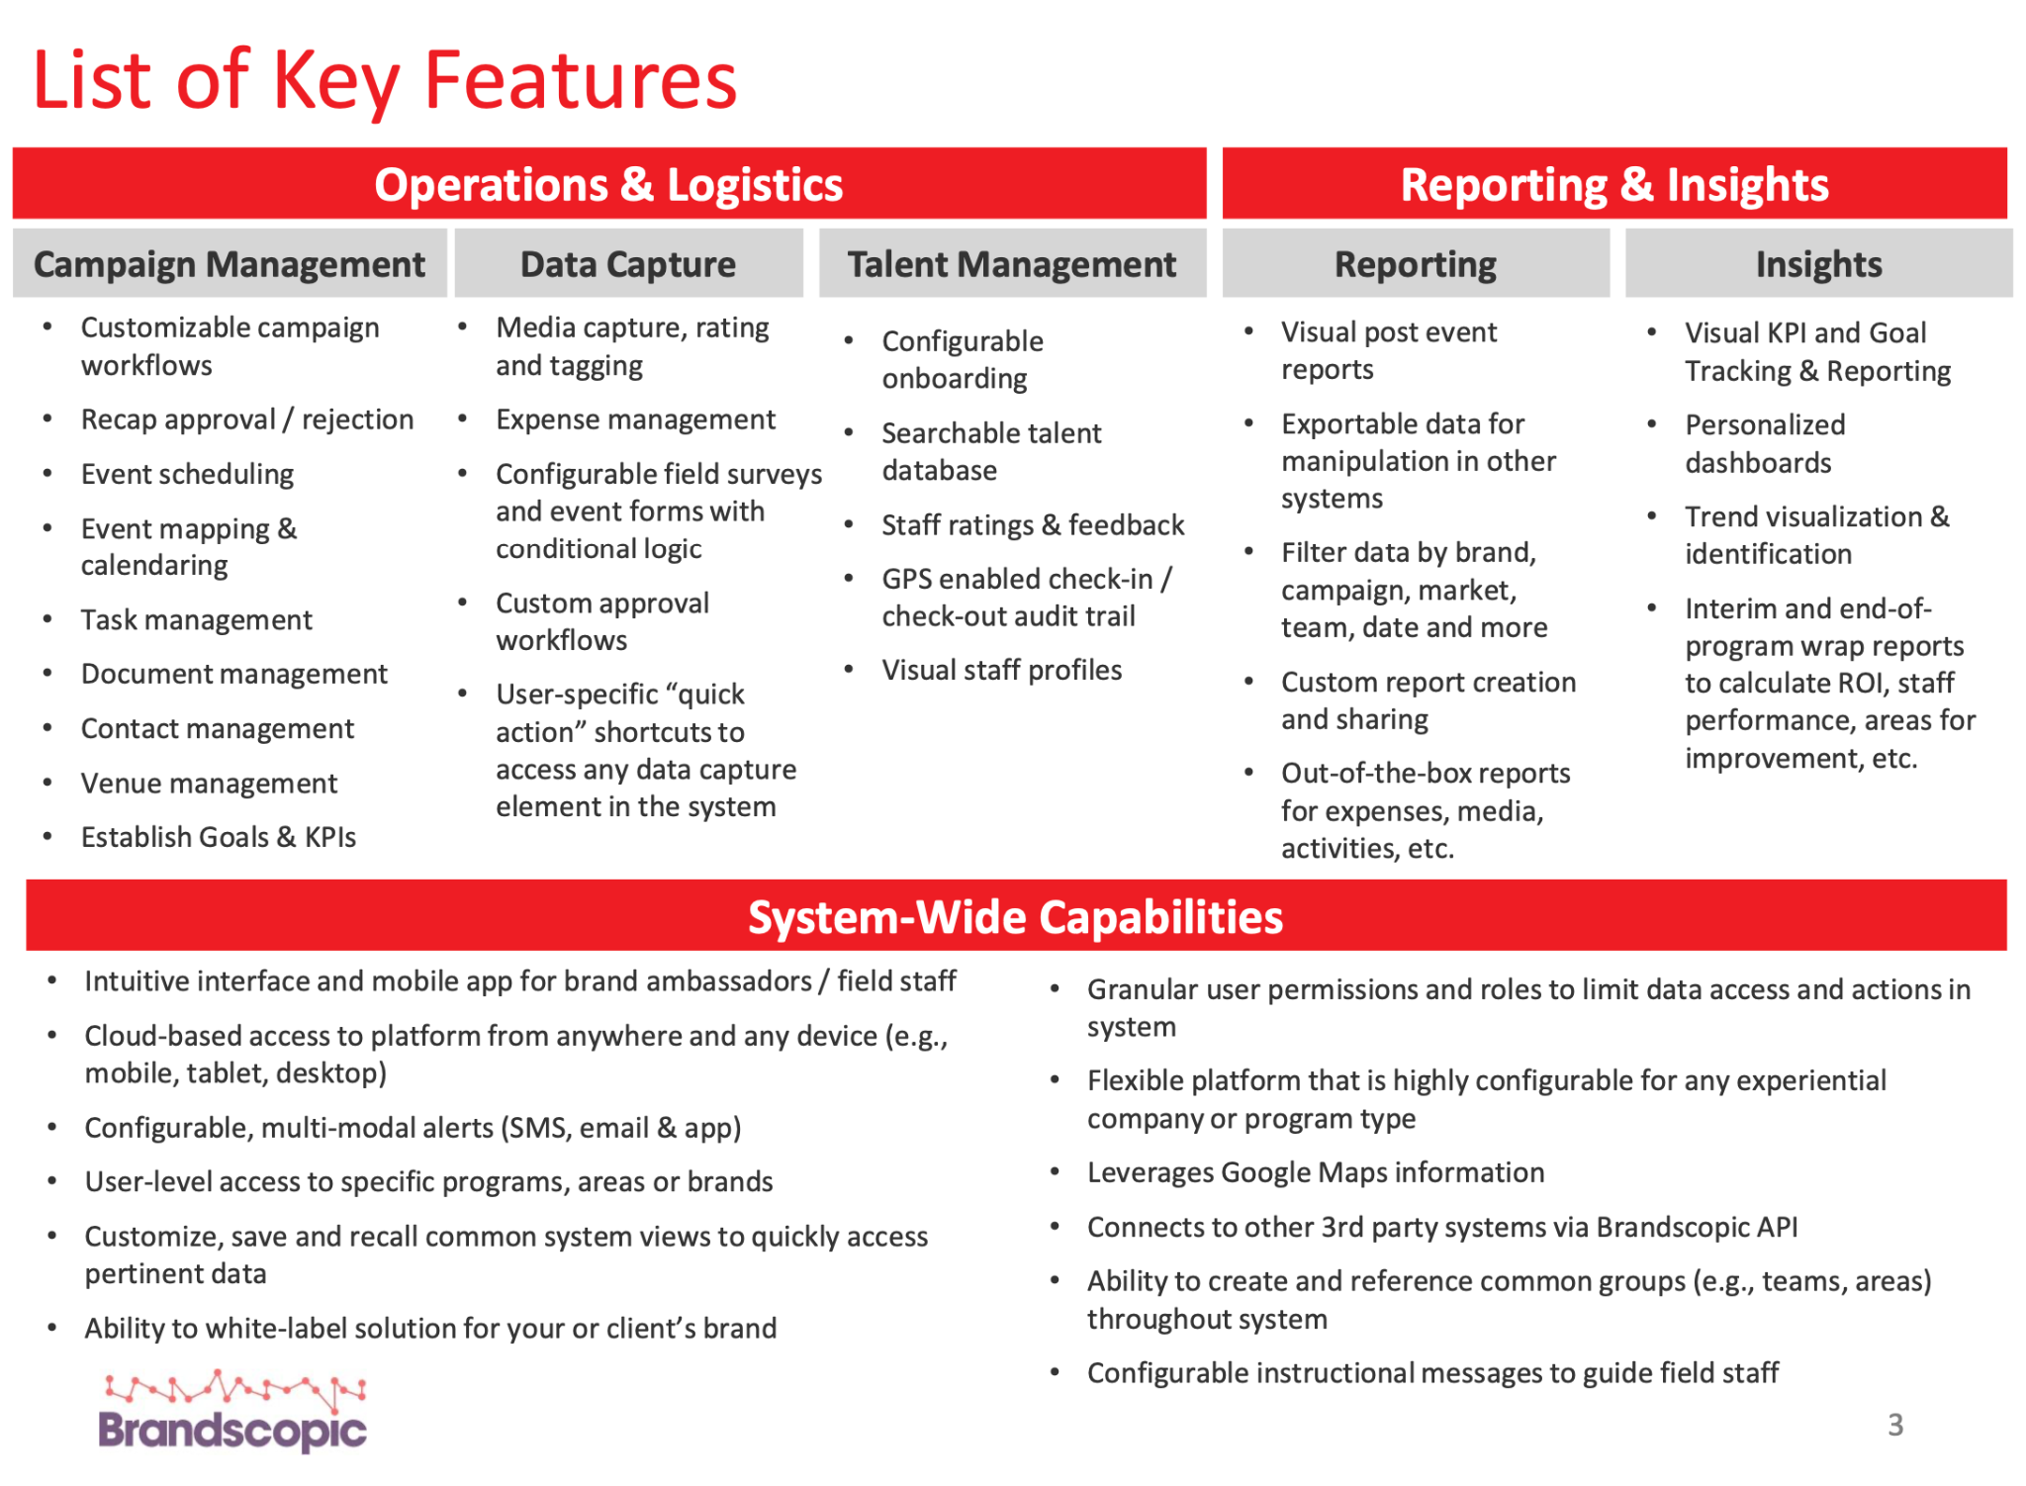

When considering key features, API abilities, and per user cost–Brandscopic is the leading platform.

Slide 10
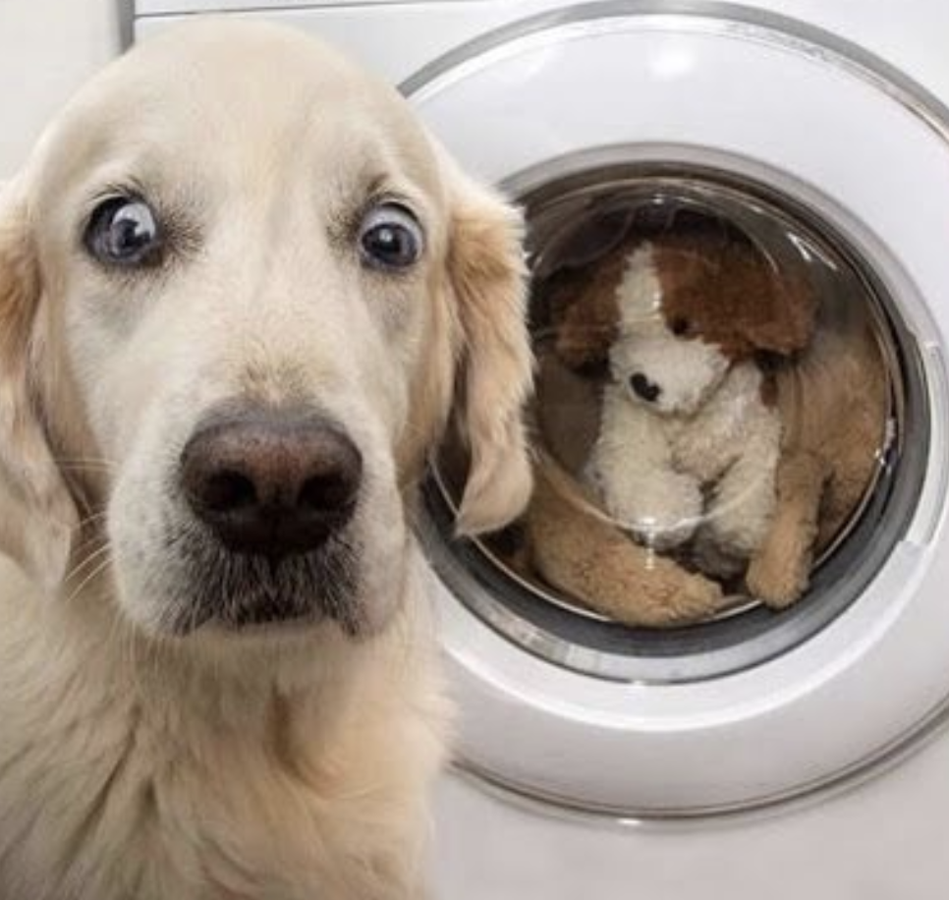
Brandscopic - how the heck do we use it?

Slide 11
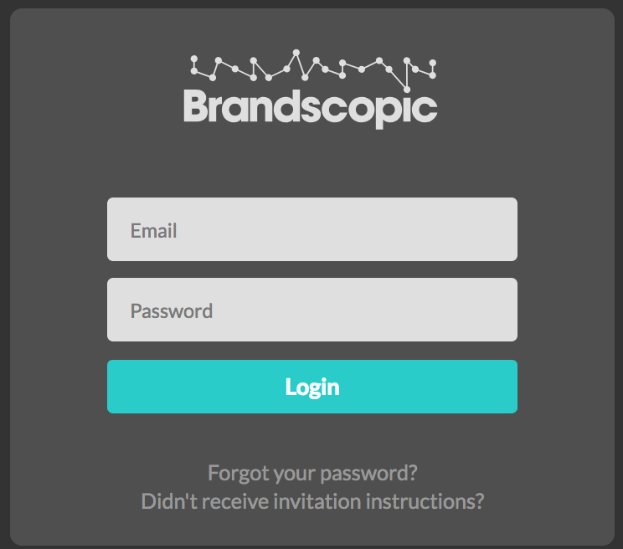
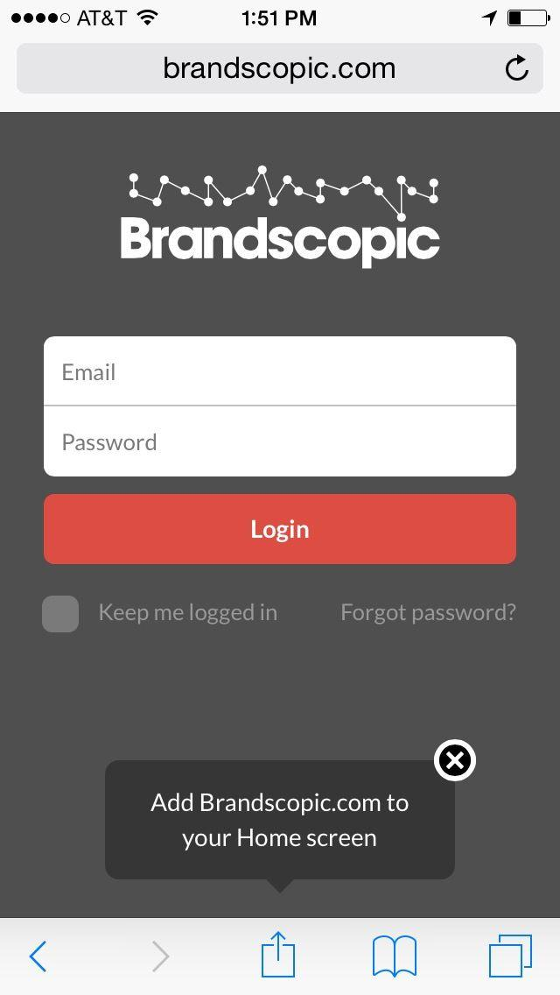
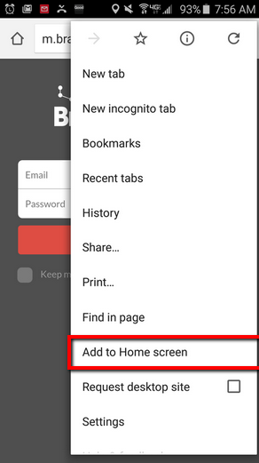
Step 1: Login to Brandscopic
On desktop:
1. Go to beta.brandscopic.com and enter your username and password.
2. Forgot password? Click this link.
On your iPhone or Android device (optional):
Users can download the Brandscopic app from the App Store or their Android device.
OR they can open a browser on their phone and go to beta.brandscopic.com.
‹#›

Slide 12
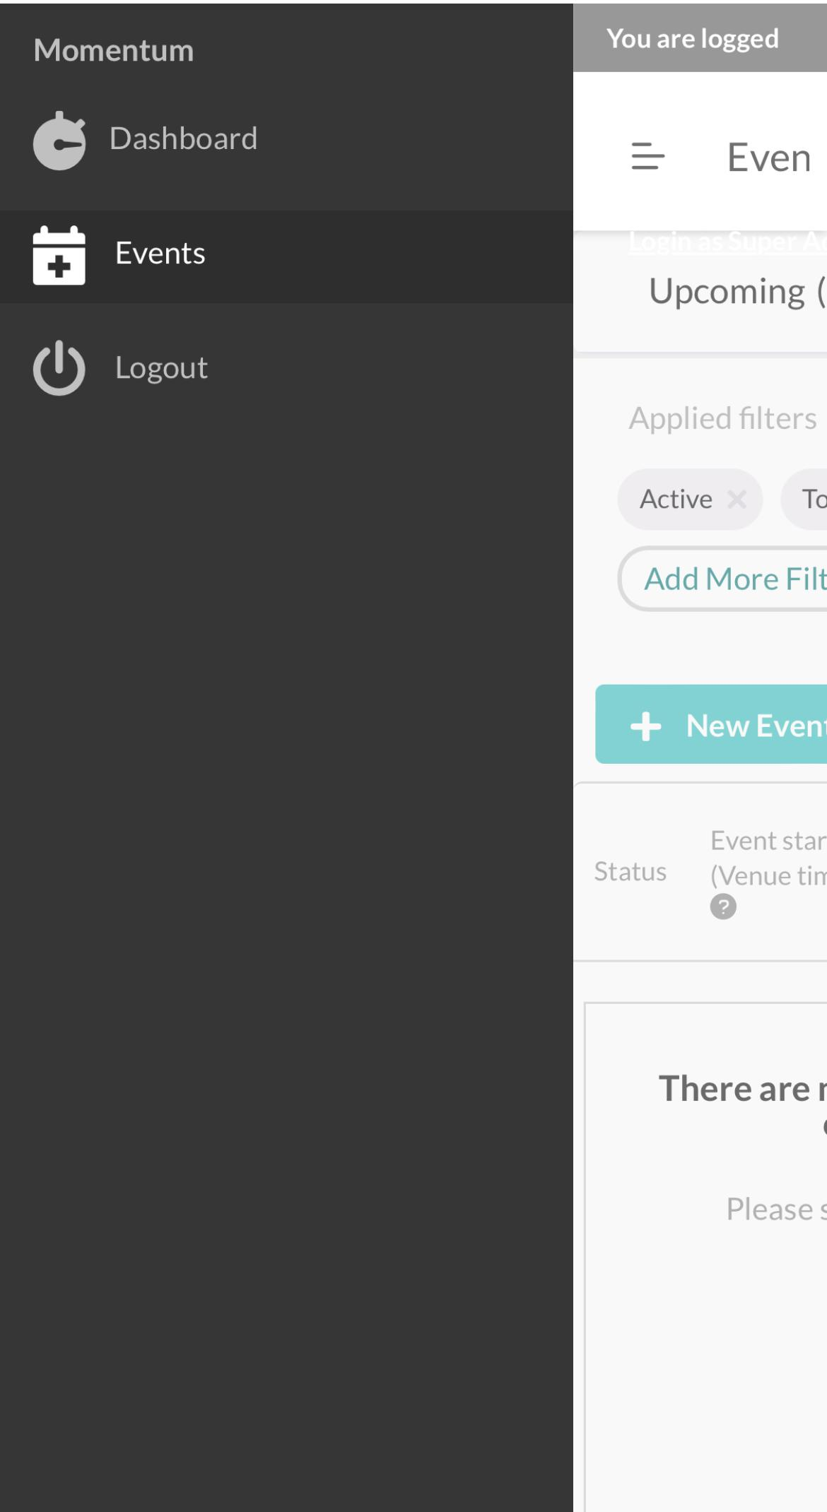
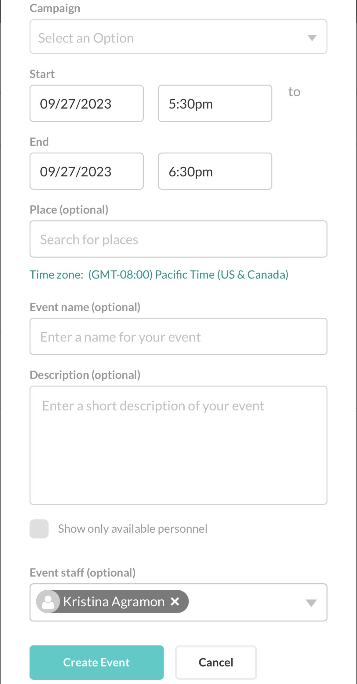
Step 2: Create an Event
To Create an Event:
1. Click on the hamburger icon
2. Click Events from the menu.
3. Click on + New Event
4. Fill out the fields and press Create Event
‹#›

Slide 13
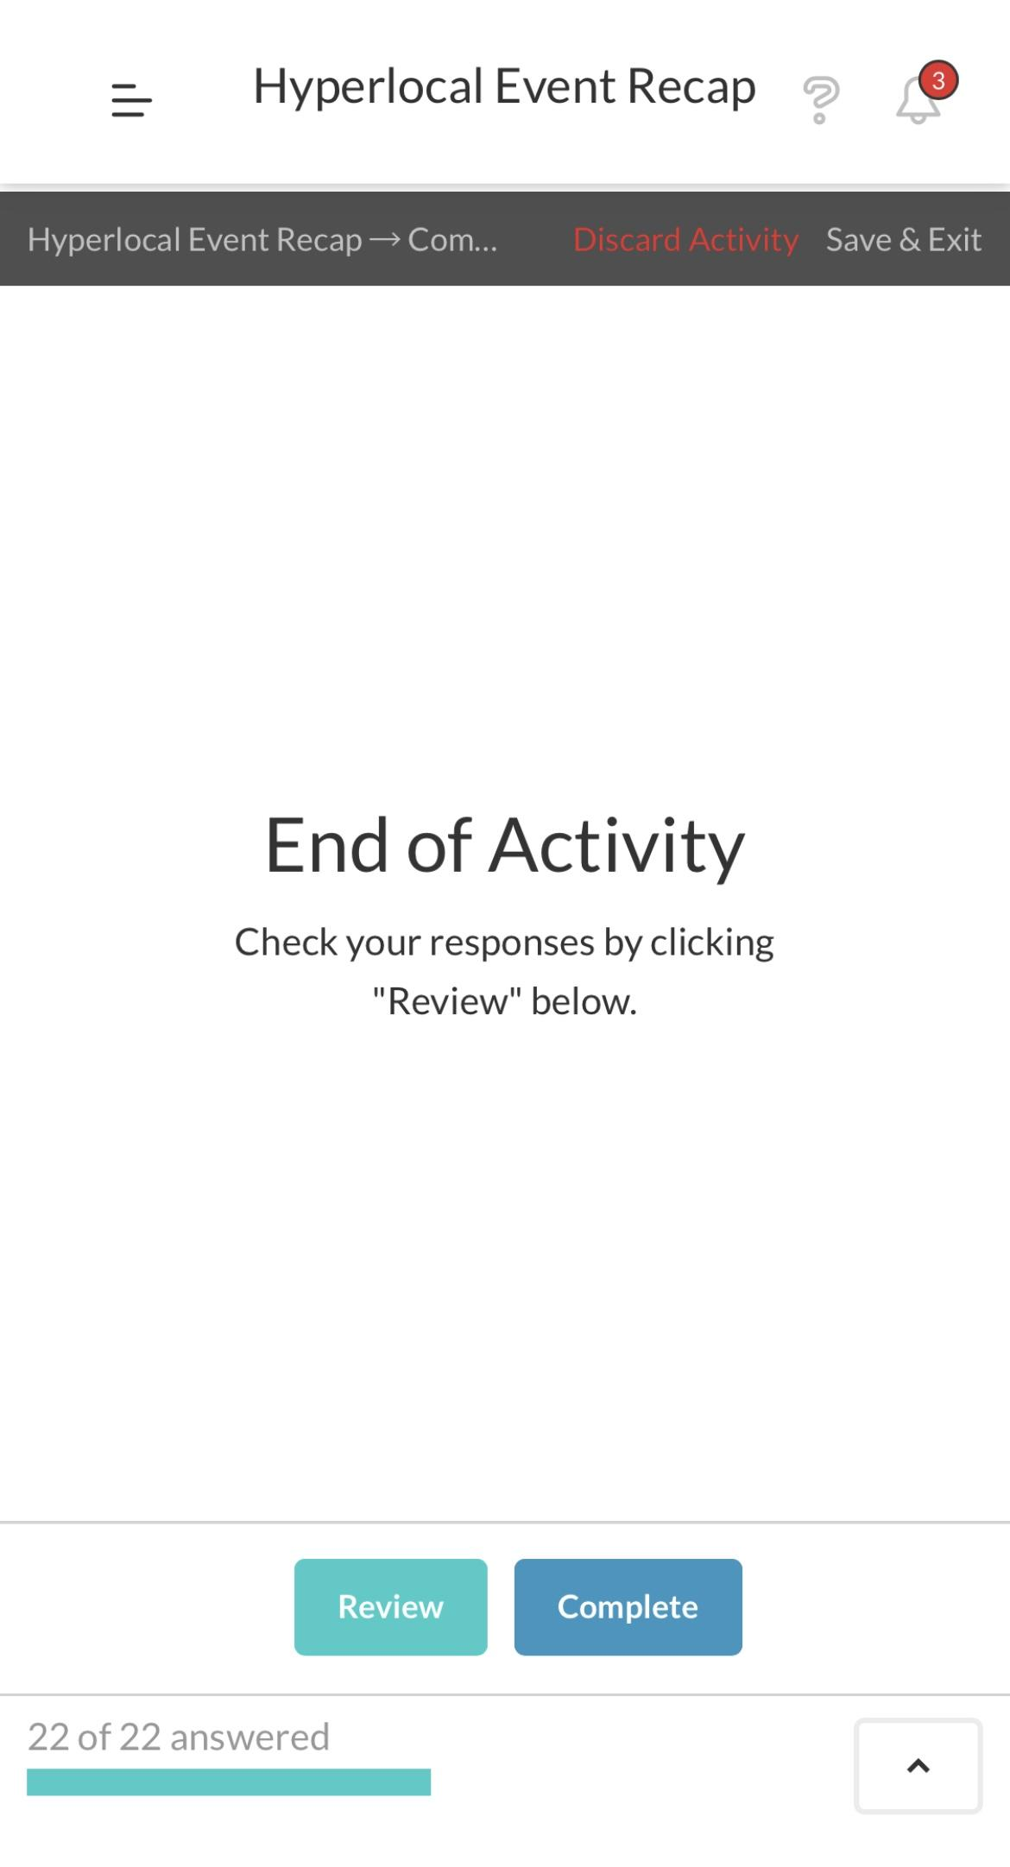
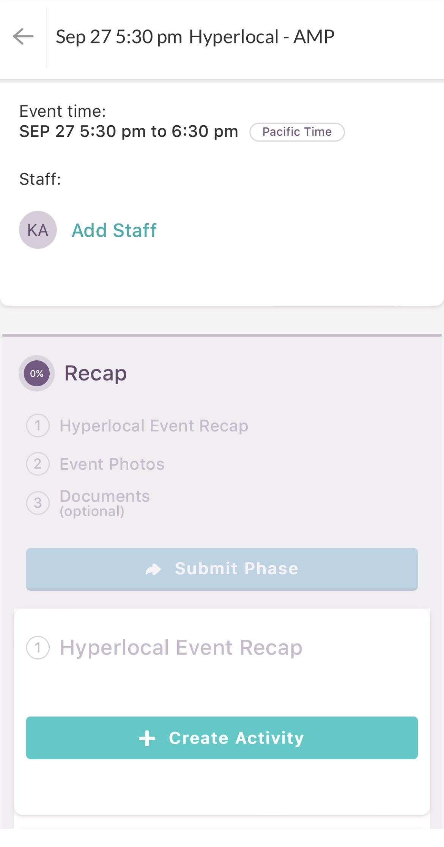
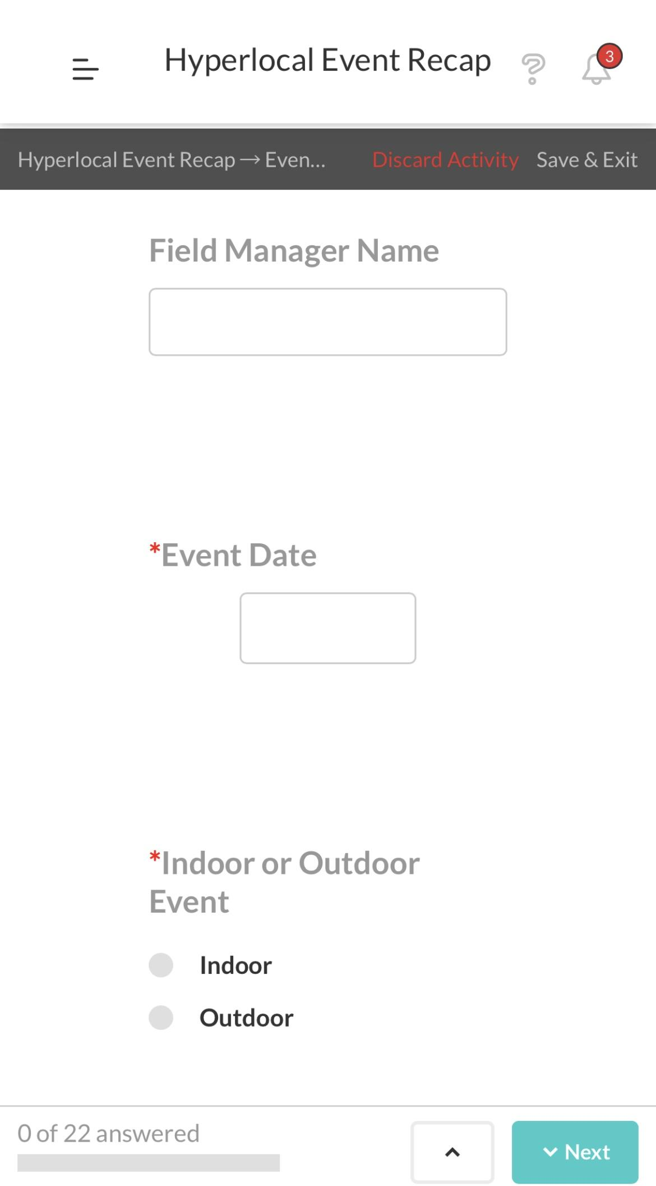
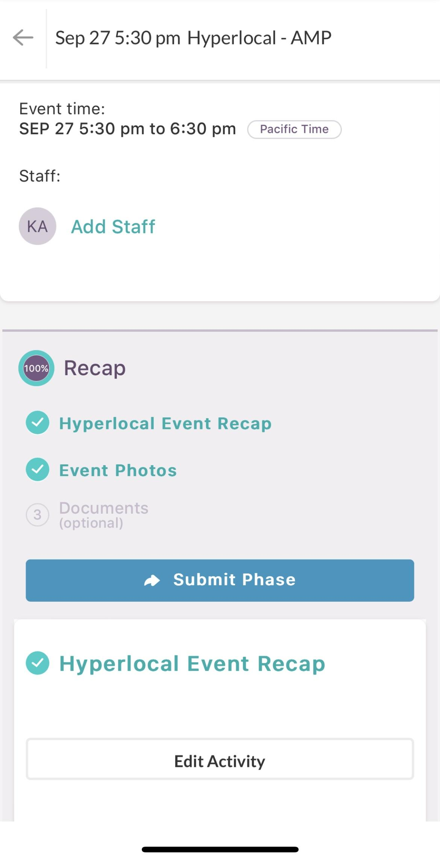
Step 3: Fill Out/ Submit Recap
Event Details
On this page you can review basic event details such as date, time and location as well as complete your recap.
To Complete Your Form:
1. Click on the event Create Activity to open your pre-event form
2. Use the Next button or scroll through the fields to complete your recap. Your work is automatically saved. If you need to leave and come back, click the Save & Exit button.
3. Once you’ve completed all required fields in your recap, click the Complete / Submit button to complete your recap
4. Once all required information has been collected, the BLUE submit button will turn bright blue and read “100%” complete. Click Submit to submit your event for approval.
‹#›

Slide 14
Issue Tracking
Add bugs / feedback / questions here during soft launch of Brandscopic
Over the next few weeks of entering events and recapping events, we will use this sheet to track any issues and questions
Kristen or Lauren should be contacted for any questions

Slide 15
Next Steps/Timing
2023
2023
2023
2024
October
November
December
January
- SSO implementation & testing
- SSO feedback addressed
- Sr. BL team + analytics check-in
Select a small group of “superusers” to use Brandscopic
Review this doc and cover notes in red
- SSO in place
- Brandscopic soft kickoff with BL superusers
- Track any questions / feedback / issues in: this tracker
- Superusers continue using Brandscopic and track any feedback
- Smartsheet will also be in place
- After 30-45 days of using Brandscopic, check-in among superusers and IP / OPs / Analytics to experience, improvements, etc
-API to UET completed
- Complete team roll out
Continue to approve and review BA experience
- Discuss phasing out smartsheet timeline
-API to MOMO BI completed

Slide 16
Additional Training Materials
Support Website: https://brandscopic.zendesk.com/hc/en-us
  How to Submit an Activity: https://brandscopic.zendesk.com/hc/en-us/articles/115002821508
  Submitting an Event Phase: https://brandscopic.zendesk.com/hc/en-us/articles/115002834928
Support Youtube Channel: https://www.youtube.com/channel/UChcfVIGq0zKf1E49HdW1ZsA
‹#›

